Slide 1


.
Technical presentation
ON
“Artificial Intelligence Approaches for UAV Navigation: Recent Advances and Future Challenges”
SUSHANT SOURAV 4PM19CS103
Technical Guide:
Dr. Sunitha B S
Associate Professor
Dept. of CS&E
Coordinator:
Dr. Sunitha B S
Associate Professor
Dept. of CS&E
Head of the Department:
Dr. Arjun U
Associate Professor and Head
Dept. of CS&E

Slide 2

CONTENTS
Introduction
Techniques Used
Benefits
Methodology
Conclusion
References

Slide 3
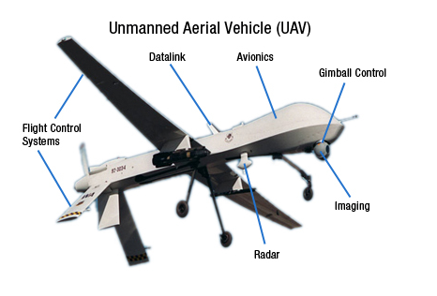
INTRODUCTION
Unmanned Aerial Vehicles (UAVs), also known as drones, have gained significant attention in recent years due to their numerous applications in various fields, including military, agriculture, search and rescue, surveillance, and aerial photography.
One of the critical challenges in UAV navigation is developing a reliable and efficient system that allows the UAV to navigate autonomously and adapt to its environment in real-time.
Artificial Intelligence (AI) approaches have emerged as a promising solution to address the challenges of UAV navigation.
These approaches involve the use of advanced algorithms that enable UAVs to perceive their environment, plan their movements, and make decisions based on their observations.

Slide 4
INTRODUCTION
The use of AI approaches for UAV navigation is an active area of research, with many new algorithms and techniques being developed.
As these approaches continue to evolve, they have the potential to unlock new capabilities and applications for UAVs in a variety of fields.
AI approaches can also be used to enable the UAV to make decisions in real-time.
For example, if the UAV detects an obstacle in its path, it can use a decision-making algorithm to choose the best course of action, such as changing its trajectory or hovering in place.
AI approaches can be used to enable UAVs to perceive their environment using sensors such as cameras, lidar, and radar. Machine learning algorithms can be used to analyze sensor data and detect objects in the environment.

Slide 5
TECHNIQUES USED
There are several techniques used in Artificial Intelligence (AI) approaches for UAV navigation. Here are some of the most common ones:
Machine Learning: Machine learning techniques are used to enable UAVs to learn from their environment and past experiences.
Computer Vision: Computer vision techniques are used to enable UAVs to perceive their environment through sensors such as cameras, lidar, and radar.

Slide 6
TECHNIQUES USED
Deep Learning: Deep learning techniques are used to enable the UAV to process complex data, such as sensor data and images, and make decisions based on this information. These algorithms can be used to enable the UAV to recognize patterns in the data, detect anomalies, and respond to changing conditions in real-time.
Swarm Intelligence: Swarm intelligence techniques involve coordinating the movements of multiple UAVs to achieve a common goal. These algorithms can be used to enable groups of UAVs to fly in formation, search for targets, and perform coordinated surveillance and reconnaissance missions.
Control Systems: Control systems are used to enable the UAV to control its movements and stabilize its position and orientation in 3D space. These algorithms can be used to maintain a stable hover, track a moving target, or perform complex maneuvers such as flips and rolls.

Slide 7
TECHNIQUES USED
Path Planning: Path planning algorithms are used to generate a trajectory for the UAV to follow based on its current position and destination. These algorithms take into account factors such as obstacles, wind, weather, and battery life, and can generate optimized flight paths that minimize energy consumption and maximize flight time.
Dijkstra’s and A* Algorithms: Dijkstra’s algorithm is a weighted graph method that calculates the shortest distance between two nodes. Dijkstra’s algorithm examines neighbors leaving a node at each step, and if a shorter path is discovered, the distances are updated.

Slide 8
BENEFITS
Autonomy: One of the primary benefits of AI approaches for UAV navigation is that they can enable UAVs to operate autonomously without human intervention. This can increase the efficiency and reliability of UAVs, as they can perform tasks more quickly and accurately than humans.
Improved Safety: AI approaches can also improve the safety of UAVs by enabling them to detect and avoid obstacles in their environment. This can reduce the risk of collisions and other accidents.
Increased Efficiency: AI approaches can optimize the flight path of UAVs to minimize energy consumption and increase flight time. This can reduce the need for frequent battery changes or refuelling, increasing the efficiency of the UAV.
Enhanced Capability: AI approaches can enable UAVs to perform tasks that would be difficult or impossible for humans to do, such as searching for targets in a large area, monitoring critical infrastructure, or performing high-altitude inspections.

Slide 9
BENEFITS
Real-time Decision-making: AI approaches can enable UAVs to make decisions in real-time based on sensor data and other inputs. This can enable the UAV to respond quickly to changing conditions and adapt its behaviour as needed.
Cost Reduction: AI approaches can reduce the cost of UAV operations by eliminating the need for human pilots and reducing the need for ground support equipment.
Increased Accessibility: AI approaches can make UAVs more accessible to a wider range of users, including those without specialized training in aviation or piloting.
Reduced Environmental Impact: AI approaches can enable UAVs to fly more efficiently, reducing their carbon footprint and environmental impact compared to traditional manned aircraft.

Slide 10
METHODOLOGY
Expert Systems: Expert systems are similar to rule-based systems but are designed to mimic the decision-making process of a human expert in a particular domain. They use a knowledge base and a set of inference rules to make decisions about how the UAV should navigate.
Rule-based Systems: Rule-based systems use a set of if-then rules to make decisions about how the UAV should navigate. These rules can be based on factors such as altitude, terrain, and obstacles in the environment.
Neural Networks: Neural networks are a machine learning approach that uses a set of interconnected nodes to process information. They can be used to enable the UAV to recognize patterns in the environment and make decisions based on this information.

Slide 11
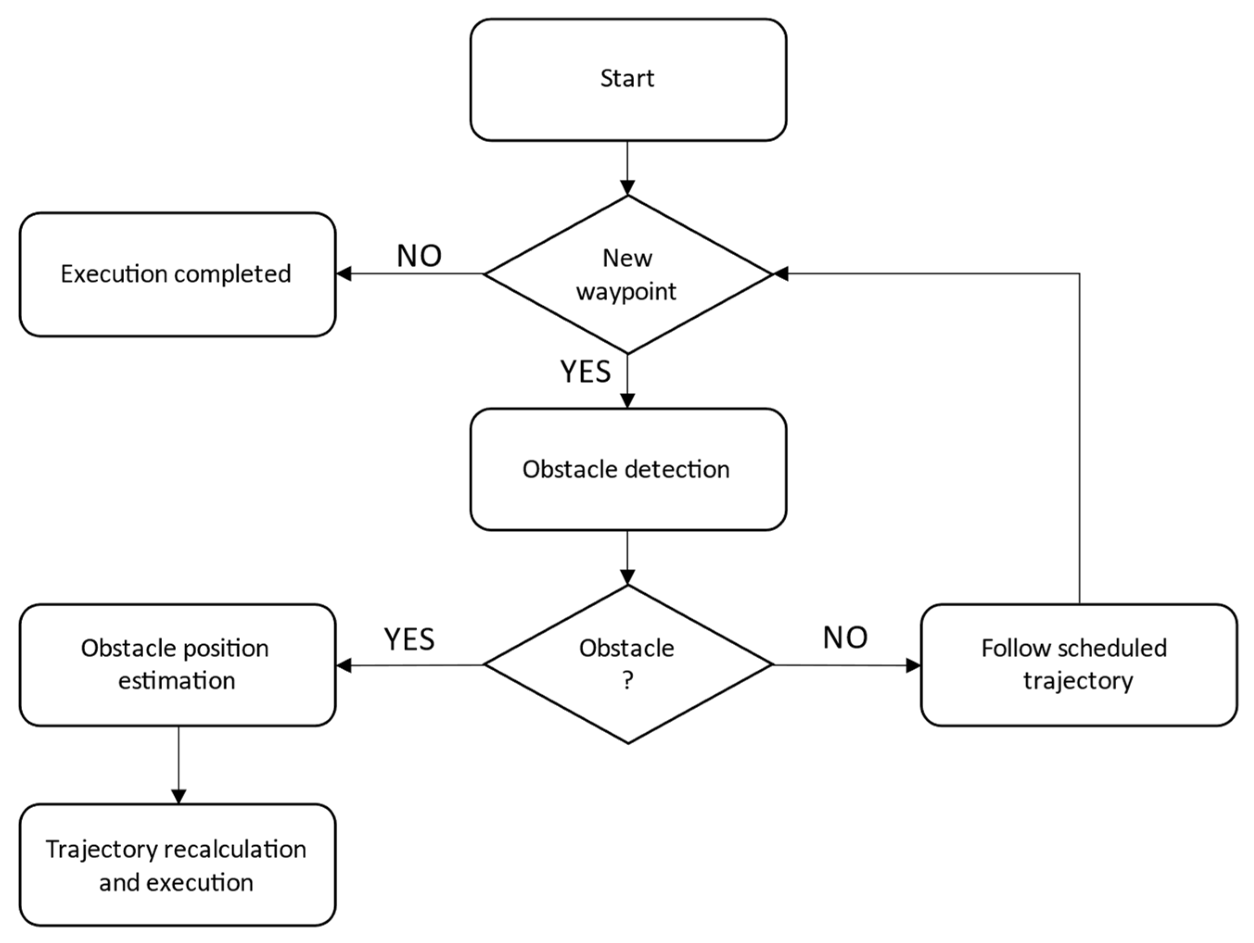
METHODOLOGY
Fig: Obstacle Detection Flow chart

Slide 12
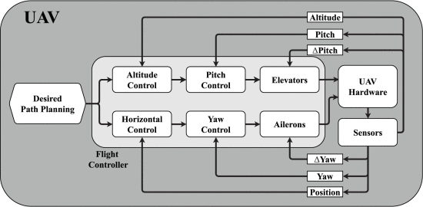
Methodology
Fig: UAV System model

Slide 13
METHODOLOGY
Pre-process Data: The data is pre-processed to remove noise and irrelevant information.
Feature Extraction: Relevant features are extracted from the data, such as object shapes and sizes, terrain elevation, and other environmental factors.
Decision-making: The UAV's AI system processes the extracted features and makes decisions about how to navigate, such as adjusting altitude, speed, or direction.
Navigation: The UAV follows the decisions made by the AI system, adjusting its flight path as needed based on new data from sensors.

Slide 14
CONCLUSION
AI approaches are highly effective in enabling autonomous navigation, control, and decision-making of UAVs in a variety of scenarios, and have greatly expanded the capabilities of UAVs, enabling them to operate in complex environments.
Machine learning algorithms, such as deep learning, have been utilized to analyze and make sense of the vast amounts of data gathered by UAV sensors, enabling more accurate and reliable navigation.
AI approaches can also enable UAVs to collaborate with other UAVs or ground-based robots to achieve a common goal, such as search and rescue missions.
However, there are also concerns about the potential risks associated with autonomous UAVs, such as the risk of collisions or privacy violations. As such, there is a need for careful regulation and oversight of the use of AI in UAV navigation.

Slide 15
REFERENCES
[1] Y. Lu, X. Zhucun, G.-S. Xia, and L. Zhang, ‘‘A survey on vision-based UAV navigation,’’ Geo-spatial Inf. Sci., vol. 21, no. 1, pp. 1–12, Jan. 2018.
[2] M. Sheraz, M. Ahmed, X. Hou, Y. Li, D. Jin, Z. Han, and T. Jiang, ‘‘Artificial intelligence for wireless caching: Schemes, performance, and challenges,’’ IEEE Commun. Surveys Tuts., vol. 23, no. 1, pp. 631–661, 1st Quart., 2021.
[3] M. Y. Arafat and S. Moh, ‘‘Bio-inspired approaches for energy-efficient localization and clustering in UAV networks for monitoring wildfires in remote areas,’’ IEEE Access, vol. 9, pp. 18649–18669, 2021.
[4] O. Esrafilian, R. Gangula, and D. Gesbert, ‘‘Three-dimensional-map- based trajectory design in UAV-aided wireless localization systems,’’ IEEE Internet Things J., vol. 8, no. 12, pp. 9894–9904, Jun. 2021.
[5] M.Mozaffari,W.Saad,M.Bennis,andM.Debbah,‘‘Wirelesscommunica- tion using unmanned aerial vehicles (UAVs): Optimal transport theory for hover time optimization,’’ IEEE Trans. Wireless Commun., vol. 16, no. 12, pp. 8052–8066, Dec. 2017.
[6] M.Kothari,I.Postlethwaite,andD.-W.Gu,‘‘Asuboptimalpathplanning algorithm using rapidly-exploring random trees,’’ Int. J. Aerosp. Innov., vol. 2, nos. 1–2, pp. 93–104, Apr. 2010.
[7] C. T. Cicek, H. Gultekin, B. Tavli, and H. Yanikomeroglu, ‘‘UAV base station location optimization for next generation wireless networks: Overview and future research directions,’’ in Proc. 1st Int. Conf. Unmanned Veh. Syst.-Oman (UVS), Feb. 2019, pp. 1–6.
[8] C. Wang, J. Wang, J. Wang, and X. Zhang, ‘‘Deep-reinforcement-learning- based autonomous UAV navigation with sparse rewards,’’ IEEE Internet Things J., vol. 7, no. 7, pp. 6180–6190, Jul. 2020.

Slide 16
THANK YOU

